Slide 1

The Modern
Organization in the
Global, Web-Based
Environment

Slide 2
Learning Objectives
Differentiate among data, information, and knowledge.
Differentiate between information technology architecture and information technology infrastructure.
Describe the global business environment and the new information technology infrastructure.
Discuss the relationships among business pressures, organizational responses, and information systems.

Slide 3
Information system (IS) & information technology (IT)
IS or Management information systems (MIS) deal with the planning for—and the development, management, and use of—information technology tools to help people perform all the tasks related to information processing and management.
Information technology (IT) relates to any computer-based tool that people use to work with information and to support the information and information processing needs of an organization.

Slide 4
Goals of IS
to economically process data into information and knowledge.
to get the right information to the right people at the right time in the right amount and in the right format.

Slide 5
Data, Information, and Knowledge
Data items → an elementary description of things, events, activities, and transactions that are recorded, classiﬁed, and stored but are not organized to convey any speciﬁc meaning.
Information → data that have been organized so that they have meaning and value to the recipient.
Knowledge → consists of data and/or information that have been organized and processed to convey understanding, experience, accumulated learning, and expertise as they apply to a current business problems.

Slide 6
Information Technology Architecture
A high-level map or plan of the information assets in an organization.
A guide for current operations and a blueprint for future directions.
Integrates the entire organization’s business needs for information, the IT infrastructure, and all applications.
Shows how all aspects of information technology in an organization ﬁt together.

Slide 7
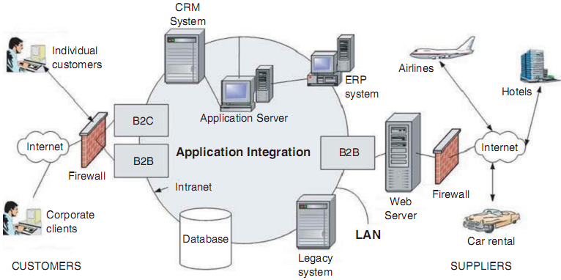
Architecture of an online travel agency.

Slide 8
Information Technology Infrastructure
Consists of the physical facilities, IT components, IT services, and IT personnel that support the entire organization.
IT components are the computer hardware, software, and communications technologies that provide the foundation for all of an organization’s information systems.
IT personnel use IT components to produce IT services, which include data management, systems development, and security concerns.

Slide 9
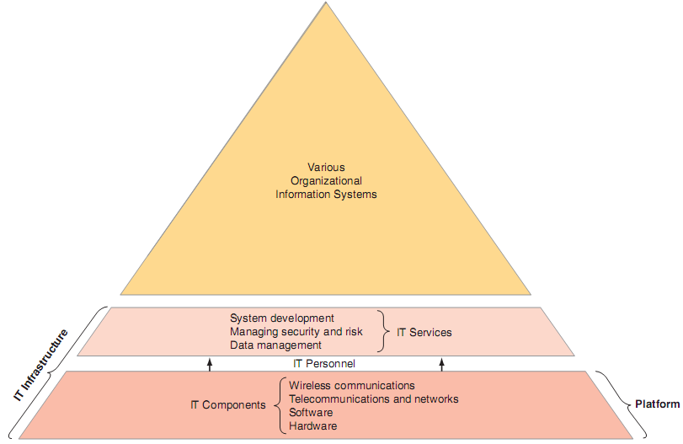
An organization’s IT components, platform, IT services, and IT
infrastructure.

Slide 10
The Global Web-Based Platform
enables individuals :
to connect, compute, communicate, collaborate, and compete everywhere and anywhere, anytime and all the time;
to access limitless amounts of information, services,and entertainment;
to exchange knowledge;
to produce and sell goods and services.

Slide 11
The Global Web-Based Platform
Operates without regard to geography, time, distance, and even language barriers.
Enables globalization.
Globalization is the integration and interdependence of economic, social, cultural, and ecological facets of life, enabled by rapid advances in information technology.

Slide 12
The Three Stages of Globalization
Thomas Friedman : The World Is Flat, Pulitzer Prize-winning.
Globalization 1.0, 1492 to 1800 : the amount of muscle, horse power, wind power, or steam power a country had and could deploy.
Globalization 2.0, lasted from 1800 to 2000 : multinational companies.
ﬁrst half : of this period, falling transportation costs, generated by the development of the steam engine and the railroads.
second half, globalization was driven by falling telecommunications costs resulting from the telegraph, telephone, computer, satellites, ﬁber-optic cable, and the Internet and World Wide Web.
Globalization 3.0 : 2000 .... : the emergence of a global, Web-based platform

Slide 13
Friedman’s Ten Flatteners
the collapse of the Berlin Wall, took place on November 9, 1989 → collapse of the Soviet Union and the communist governments of Eastern Europe in 1991.
Netscape went public, August 9, 1995.
The development of workﬂow software → enables computer applications to interoperate, or communicate and work with one another without human intervention.
Uploading, means that anyone can create and upload content to the Web → the form of open source software.

Slide 14
Friedman’s Ten Flatteners
Outsourcing, involves taking a speciﬁc function that the company was doing itself, having another company perform that same function and then integrating their work back into the operation.
Companies outsource so that they can lower costs
and concentrate on their core competencies.
Offshoring, occurs when a company moves an entire operation, or certain tasks, to another country.

Slide 15
Friedman’s Ten Flatteners
Supply chaining, occurs when companies, their suppliers, and their customers collaborate and share information.
Insourcing, delegates operations or jobs within a business to another company, which specializes in those operations.
Informing, is the ability to search for information, and it is best illustrated by search engines.
the steroids because they amplify the other ﬂatteners.
enable all forms of computing and collaboration to be digital, mobile, and personal.
new and dynamic forms of information technologies: computing, insant messaging and file sharing, video conferencing, computer graphics.

Slide 16
Exercise
What are the characteristics of the modern business environment?
Describe the Web-based, global platform.
Describe the platform used by Google, Amazon, and other companies.

Slide 17
Business Pressures
The business environment is the combination of social, legal, economic, physical, and political factors that affect business activities.
three types of business pressures:
market,
technology,
societal .

Slide 18
1. Market Pressures
Market pressures are generated by:
the global economy and strong competition
facilitated by the emergence of the global, Web-based platform.
Global competition, Cost of labors.
the changing nature of the workforce : IT is also enabling people to work from home > minorities, dissabilities
powerful customers : CRM >become more knowledgeable about the availability and quality of products and services.

Slide 19
2. Technology Pressures
Technological Innovation and Obsolescence. >New and improved technologies rapidly create or support substitutes for products, alternative service options, and superb quality.
Information Overload

Slide 20
3. Societal/Political/Legal Pressures
Social Responsibility.
One social problem that affects modern business is the digital divide
Compliance with Government Regulations and Deregulation
health, safety, environmental control, and equal opportunity
Protection against Terrorist Attacks.
Ethical Issues.

Slide 21
Organizational Responses
Organizations are responding to these pressures by implementing IT such as:
Strategic systems
Customer focus
Make-to-order and mass customization
E-business and E-commerce

Slide 22
Strategic Systems
Provide organizations with advantages that enable them:
To increase their market share and/or proﬁts,
To better negotiate with suppliers,
To prevent competitors from entering their markets.

Slide 23
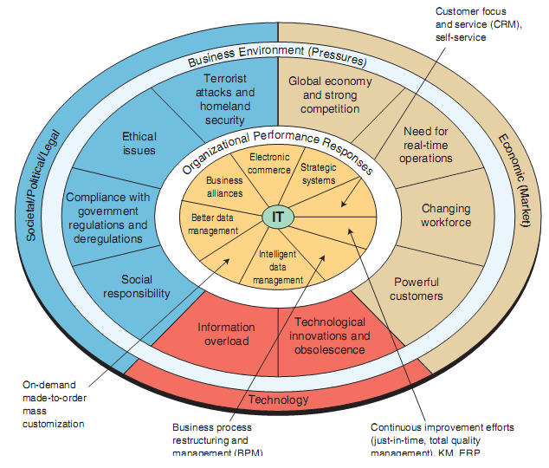

Slide 24
Why Are Information Systems Important to You?

Slide 25
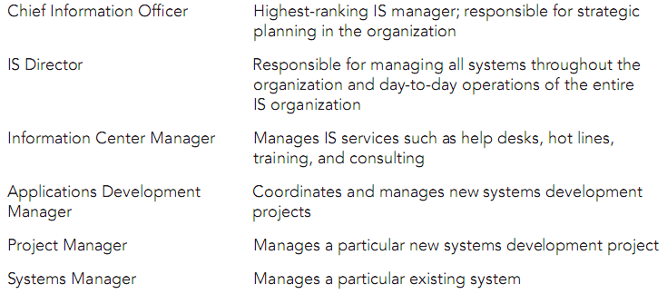
IT Offers Career Opportunities

Slide 26
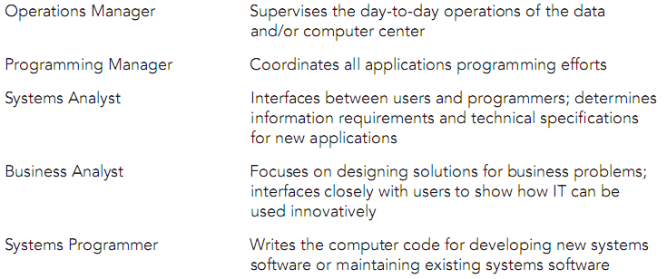
IT Offers Career Opportunities

Slide 27
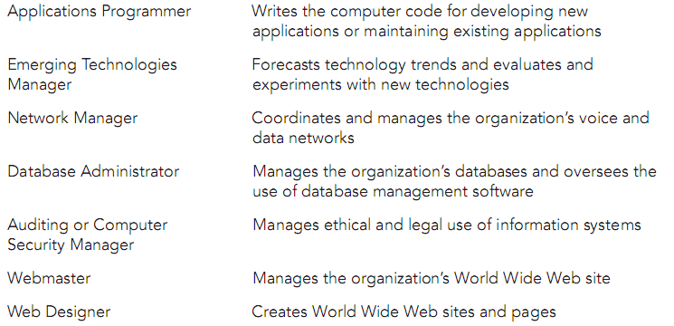
IT Offers Career Opportunities

Slide 28
IT Is Used by All Departments

Slide 29
TASK :
Review the newspapers for the last three months to ﬁnd
stories about the use of Web-based technologies in
organizations. Each group will prepare a report de-
scribing ﬁve applications. The reports should empha-
size the role of the Web and its beneﬁt to the
organizations. Cover issues described in this chapter,
such as productivity, competitive strategies, and glob-
alization. Present and discuss your work.

